Slide 1

Predicting Customer Churn Lighthouse Labs
Zara Faraz

Slide 2
Introduction
Education
Masters in Finance
Bachelors in International Business Management
Data Science Bootcamp
Certified Digital Marketer
Work Experience
Business Analyst – FinTech
Business Analyst – Solution Provider
Skills/Technologies
Database
Kentico (CMS)
Visualization Tools
Languages: Python, SQL query, JSON, R, HTML, CSS, JS
IBM SPSS, EViews, Google Analytics, Gretle
Azure Devops, Bugzilla, JIRA, BrowserStack, Confluence
Flask, AWS

Slide 3
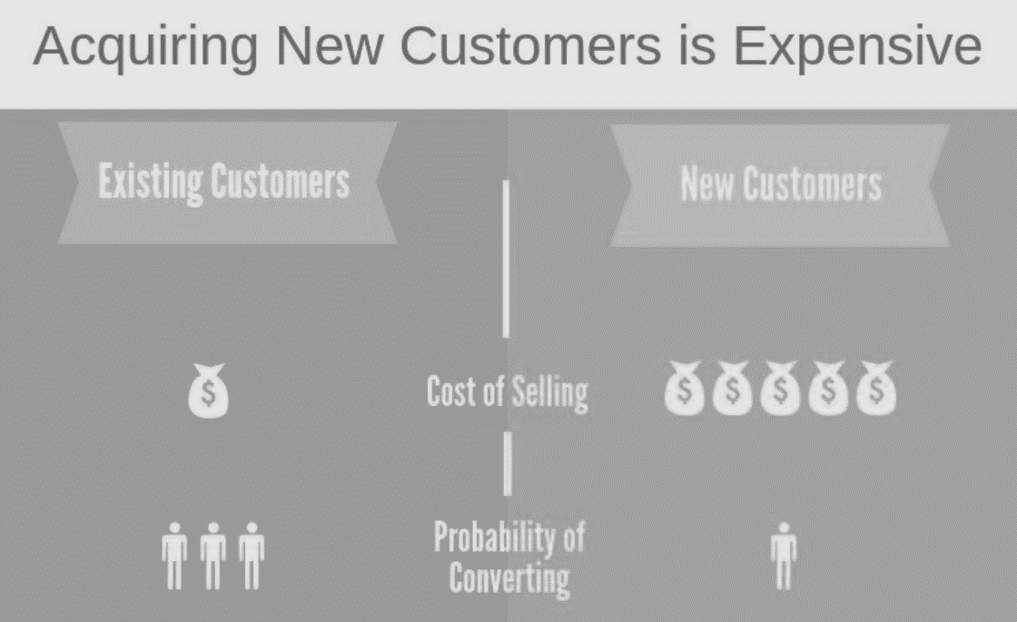
What is Customer Churn?
Customer churn is when someone chooses to stop using your products or services.
Market Competition
Negative brand image
Acquisition cost
Company Growth

Slide 4
Use Case for Churn Prediction
Target Variable = Churn [Yes / No]
Importance of study
Understand and Predict customers at risk of churn
Identify significant features that can help understand churn
Industry = Telecommunication
Company = Telco
Data Source = Kaggle

Slide 5
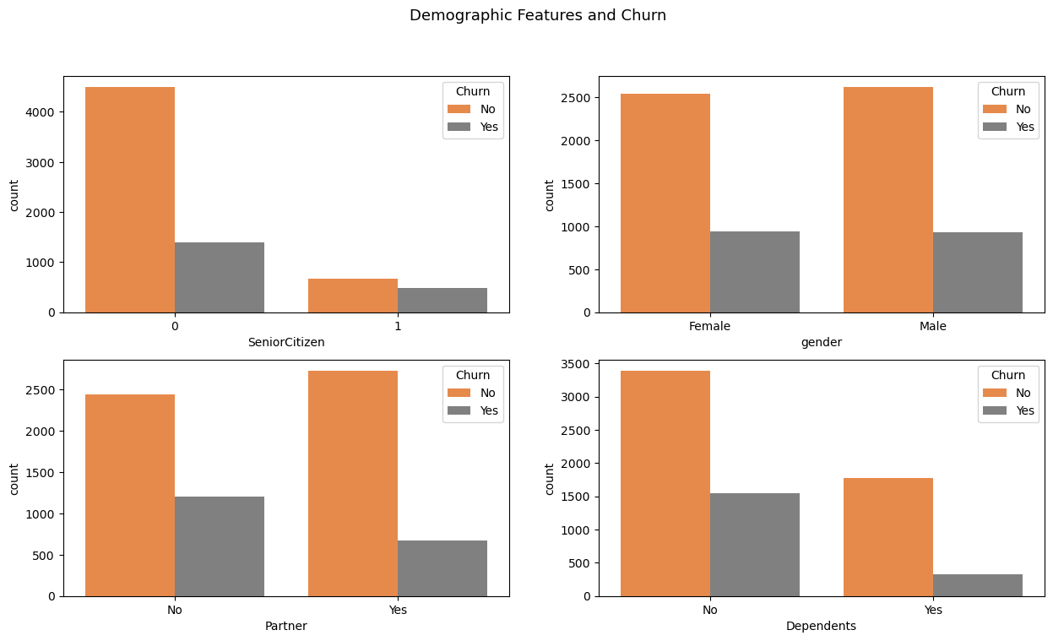
Demographic Analysis
Younger customers are churning at an alarming rate
Not a significant difference in churn between Male and Female Customers
Customers with NO Partners and NO dependents are churning more

Slide 6
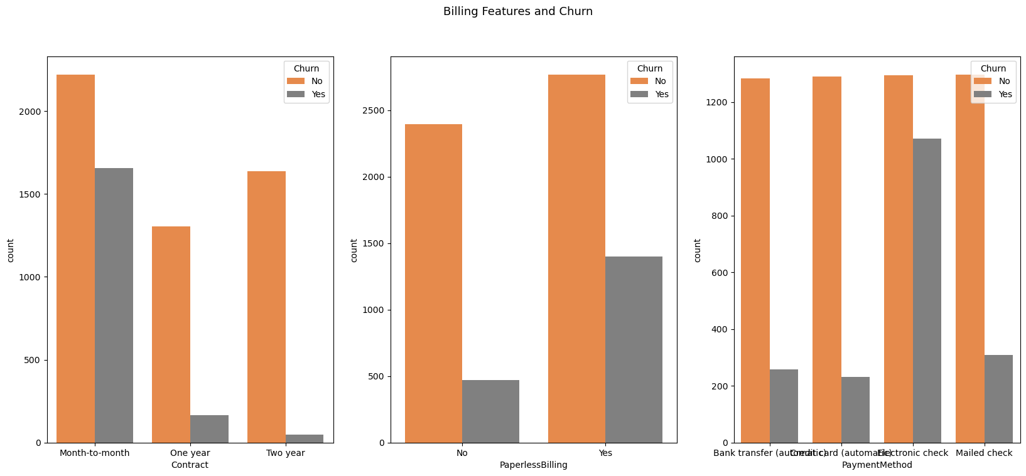
Payment and Plan Analysis
Customer who use the services and pay month-to-month are the most likely to Churn
Customers who pay via Electronic Check are also at a great risk of Churn

Slide 7
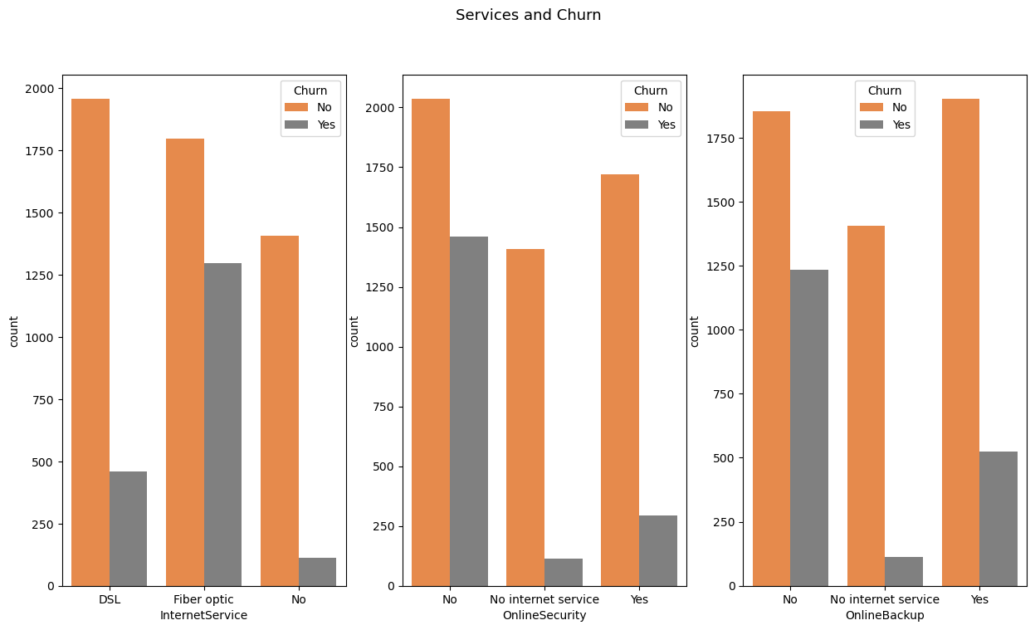
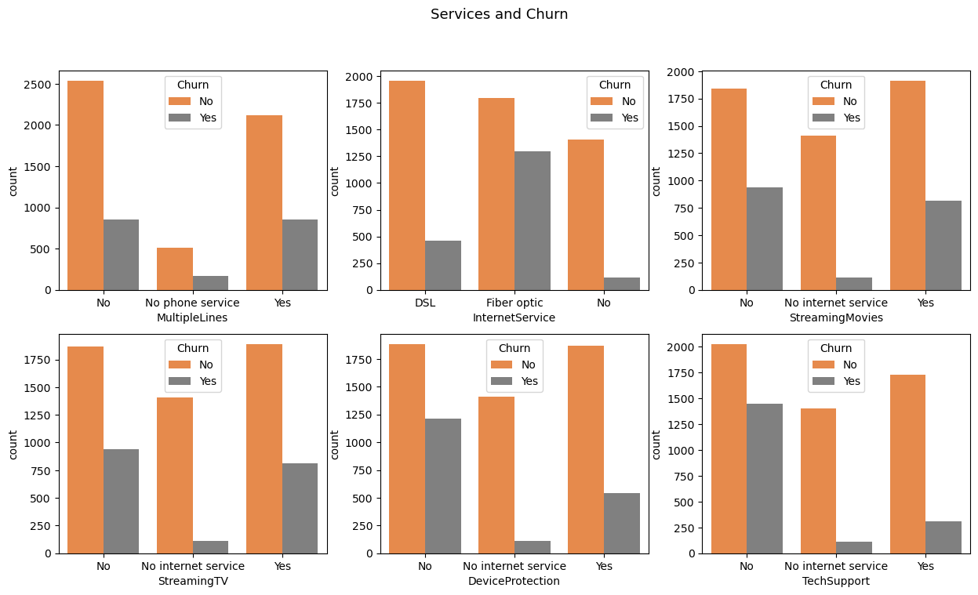
Services Analysis
Multiple services offered by the company
Phone
Internet
Streaming
Device Protection
Tech support
Online Security and Backup
Some customers are using a single service while others are using a mix of services
Churn is present in almost all of them

Slide 8
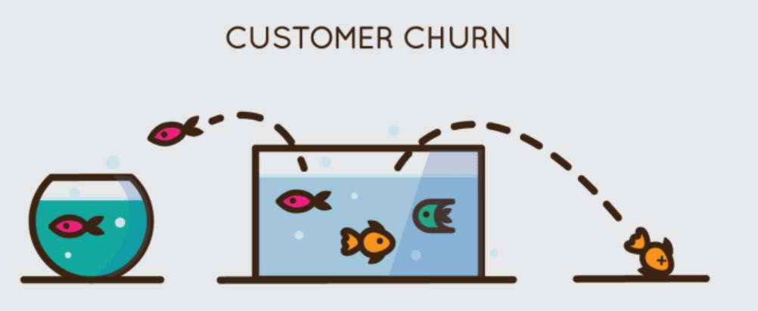
Significant Features
Churn
Internet Service
Paperless Billing
Senior Citizen
Multiple Lines
Online Backup
Online Security
Total Charges
Contract Type
Phone Services
Monthly Charges
Tech Support
Gender
There are around 20 features that we started to explore our dataset with.
By executing a Regression Analysis we were able to highlight 12 significant features that cause a customer to churn.

Slide 9

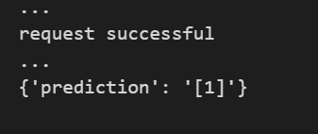
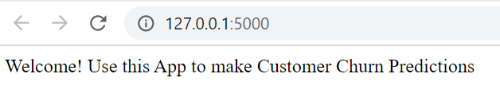
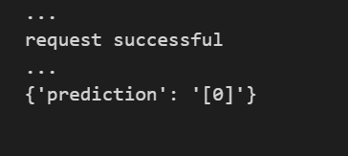
Predicting Customer Churn
Tested out multiple models to see which model can provide us with the best prediction results.
Logistic Regression can successfully predict customers that might Churn with a rate of 78.72% (Highest Score)
Created a Web Application for the model using Flask and deployed it to make predictions
Loaded Test Case and the model predicted that the customer would churn
Test Case where model predicted that the customer will not churn and continue with the company

Slide 10
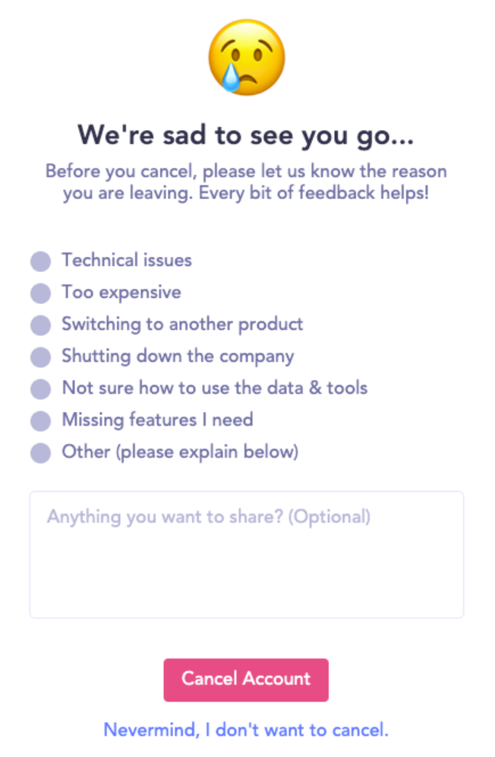
Measures
Send an email after customers cancel to enquire why they cancelled directly in the email or direct them to a questionnaire
Service quality
Product fit
Different target audience
Pricing
Competitor offering
Promotion or renewal offers are not right
0% churn rate is impossible. The trick is to always keep the churn rate as low as possible.

Slide 11

Future Work/Challenges
More data points could have been collected in the data
Imbalance data
Implement a webform that can capture inputs of customers and use it to display the predicted output
Flexible model: Can be used to predict employee churn or any other predictions

